Slide 1
Micro Credit Defaulters
Presented by:-
Vaishali shukla

Slide 2
Introduction
Our client, a telecom operator, offers loans of values 5 & 10 Rupiah in collaboration with a Microfinance Institute (MFI).
This is a high risk-high return venture (high risk of default as loans are being offered to low income populations and high returns of 20% within 5 days)
The objective is to study the behaviour of defaulters as well as prepare a machine learning model to classify all defaulters using the sample dataset provided by the client
We’ll also test multiple classifier algorithms with multiple evaluation metrics and select the best model based on proper metric, perform GridSearchCV for best parameter settings

Slide 3
Dataset and Features
The dataset contains default status of users along with associated features.
We’ll also look into what the distribution of a feature means as well as how these features relate with loan defaults

Slide 4
Description of Features
S. No | Variable | Definition
1 | label | Flag indicating whether the user paid back the credit amount within 5 days of issuing the loan{1:success, 0:failure}
2 | msisdn | mobile number of user
3 | aon | age on cellular network in days
4 | daily_decr30 | Daily amount spent from main account, averaged over last 30 days (in Indonesian Rupiah)
5 | daily_decr90 | Daily amount spent from main account, averaged over last 90 days (in Indonesian Rupiah)
6 | rental30 | Average main account balance over last 30 days
7 | rental90 | Average main account balance over last 90 days
8 | last_rech_date_ma | Number of days till last recharge of main account
9 | last_rech_date_da | Number of days till last recharge of data account
10 | last_rech_amt_ma | Amount of last recharge of main account (in Indonesian Rupiah)
11 | cnt_ma_rech30 | Number of times main account got recharged in last 30 days
12 | fr_ma_rech30 | Frequency of main account recharged in last 30 days

Slide 5
S. No | Variable | Definition
13 | sumamnt_ma_rech30 | Total amount of recharge in main account over last 30 days (in Indonesian Rupiah)
14 | medianamnt_ma_rech30 | Median of amount of recharges done in main account over last 30 days at user level (in Indonesian Rupiah)
15 | medianmarechprebal30 | Median of main account balance just before recharge in last 30 days at user level (in Indonesian Rupiah)
16 | cnt_ma_rech90 | Number of times main account got recharged in last 90 days
17 | fr_ma_rech90 | Frequency of main account recharged in last 90 days
18 | sumamnt_ma_rech90 | Total amount of recharge in main account over last 90 days (in Indonesian Rupiah)
19 | medianamnt_ma_rech90 | Median of amount of recharges done in main account over last 90 days at user level (in Indonesian Rupiah)
20 | medianmarechprebal90 | Median of main account balance just before recharge in last 90 days at user level (in Indonesian Rupiah)
21 | cnt_da_rech30 | Number of times data account got recharged in last 30 days
22 | fr_da_rech30 | Frequency of data account recharged in last 30 days
23 | cnt_da_rech90 | Number of times data account got recharged in last 90 days
24 | fr_da_rech90 | Frequency of data account recharged in last 90 days

Slide 6
S. No | Variable | Definition
25 | cnt_loans30 | Number of loans taken by user in last 30 days
26 | amnt_loans30 | Total amount of loans taken by user in last 30 days
27 | maxamnt_loans30 | maximum amount of loan taken by the user in last 30 days
28 | medianamnt_loans30 | Median of amounts of loan taken by the user in last 30 days
29 | cnt_loans90 | Number of loans taken by user in last 90 days
30 | amnt_loans90 | Total amount of loans taken by user in last 90 days
31 | maxamnt_loans90 | maximum amount of loan taken by the user in last 90 days
32 | medianamnt_loans90 | Median of amounts of loan taken by the user in last 90 days
33 | payback30 | Average payback time in days over last 30 days
34 | payback90 | Average payback time in days over last 90 days
35 | pcircle | telecom circle
36 | pdate | date

Slide 7
Data Cleaning & Pre-processing
The dataset needs cleaning as there are a lot of garbage & outlier values, luckily there’s no missing value
Many features which do no relate with default status or have highly skewed data need to be dropped before data analysis & modelling
The constraint with data cleaning is that we cannot loose too much data, so instead of removing all data points having z>3, we’ll use visualization and consider the data lost while cleaning

Slide 8
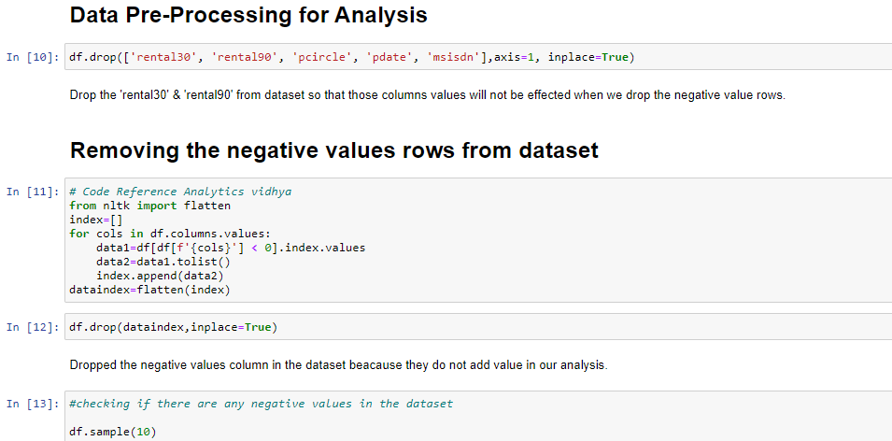

Slide 9
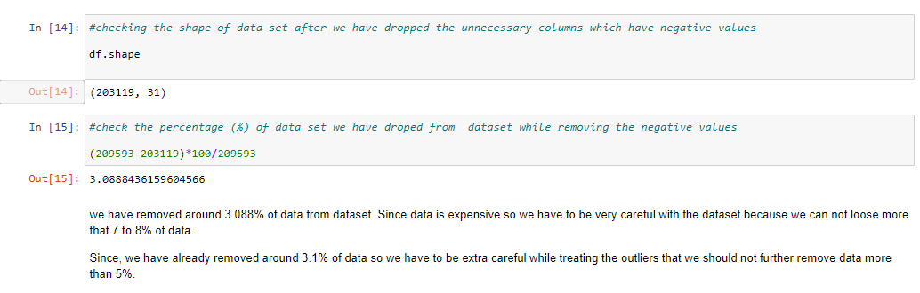

Slide 10
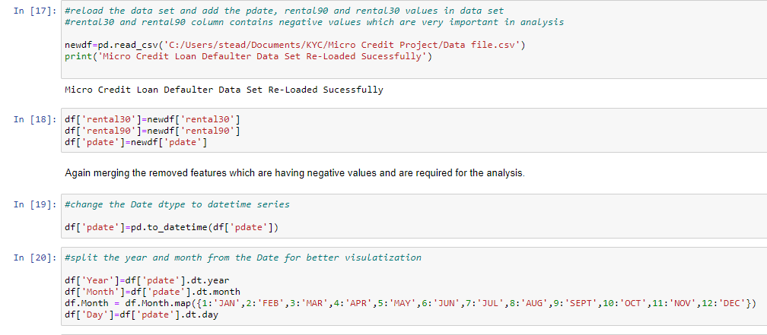

Slide 11
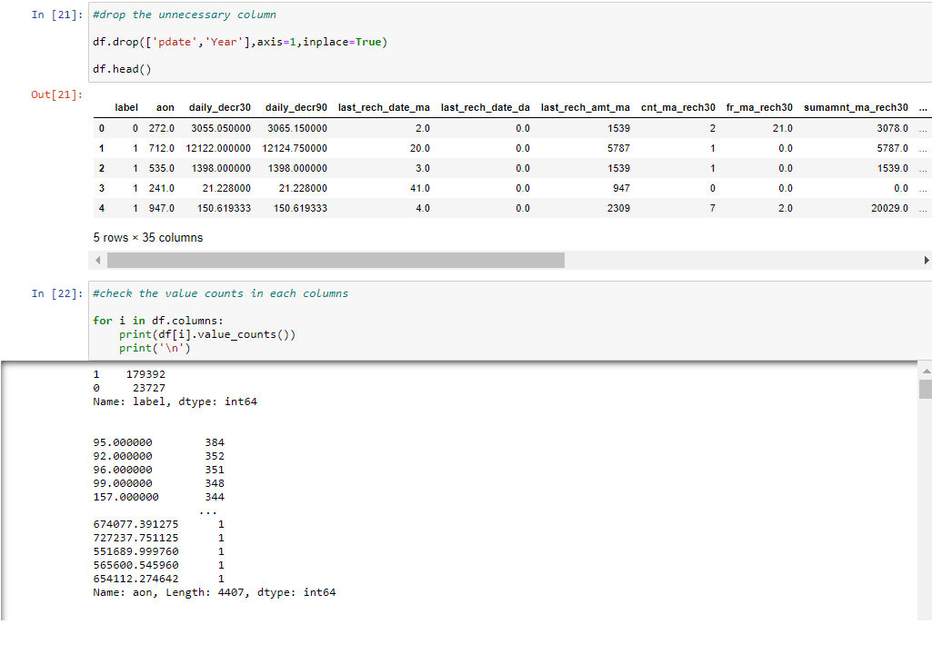

Slide 12
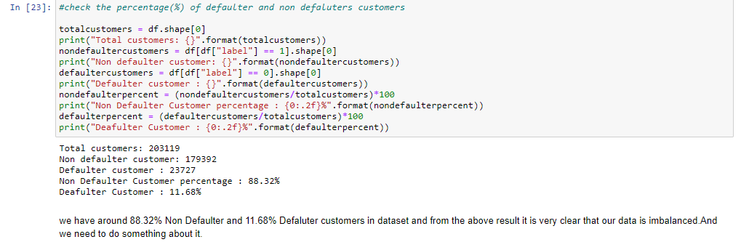

Slide 13
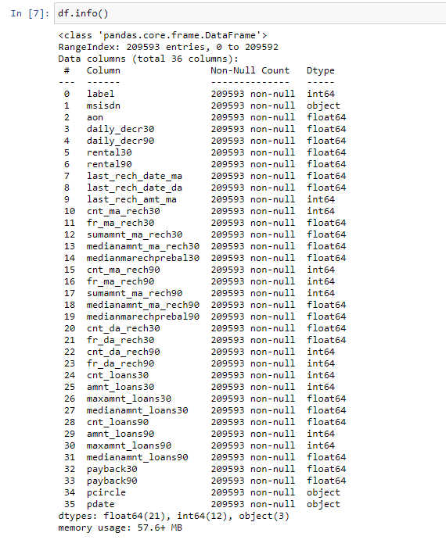
Data Analysis & Visualization
Dataset Data types are as follows

Slide 14
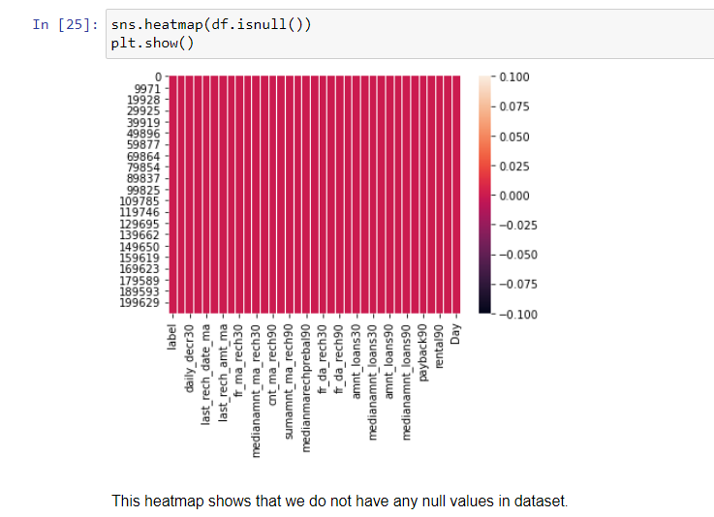

Slide 15
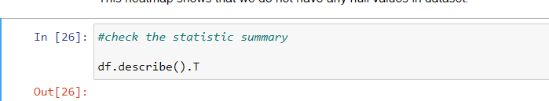
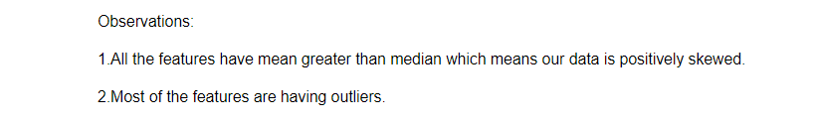
Statistical summary

Slide 16
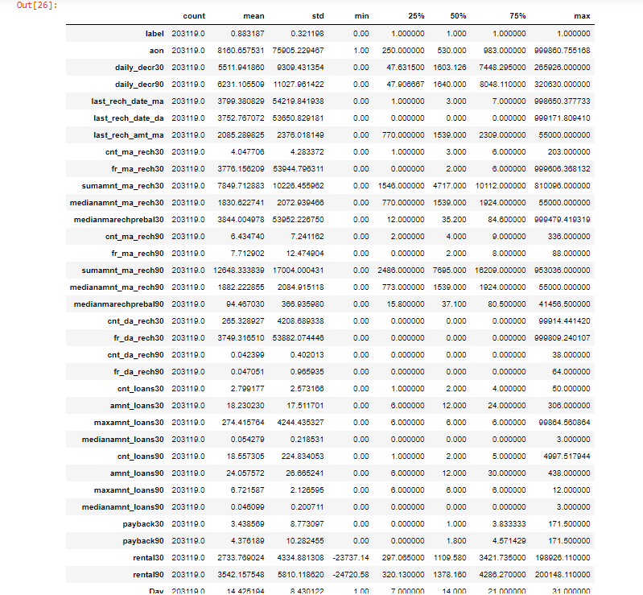

Slide 17
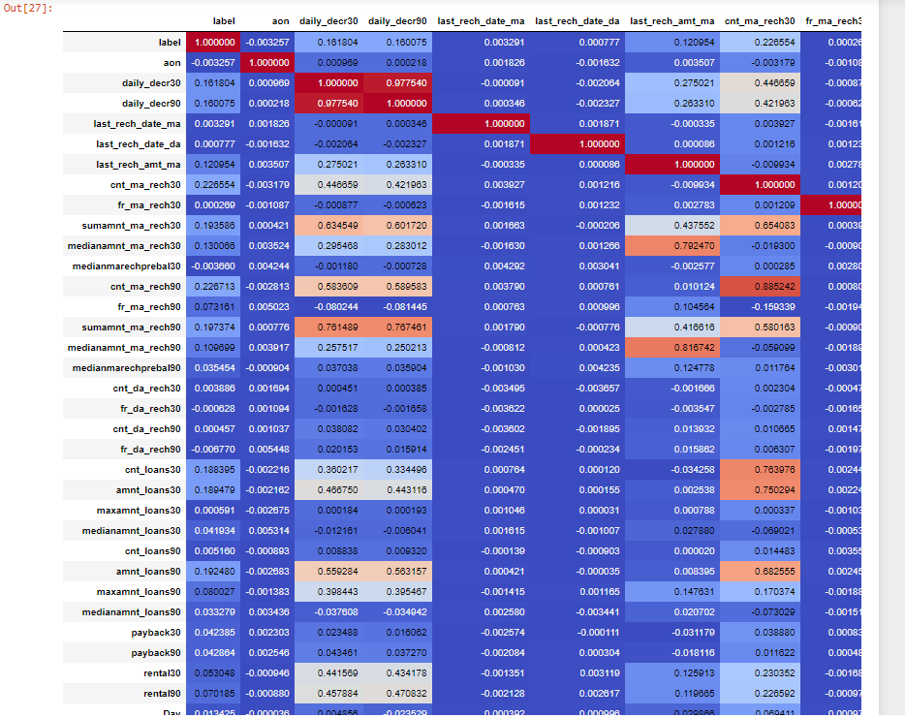

Slide 18
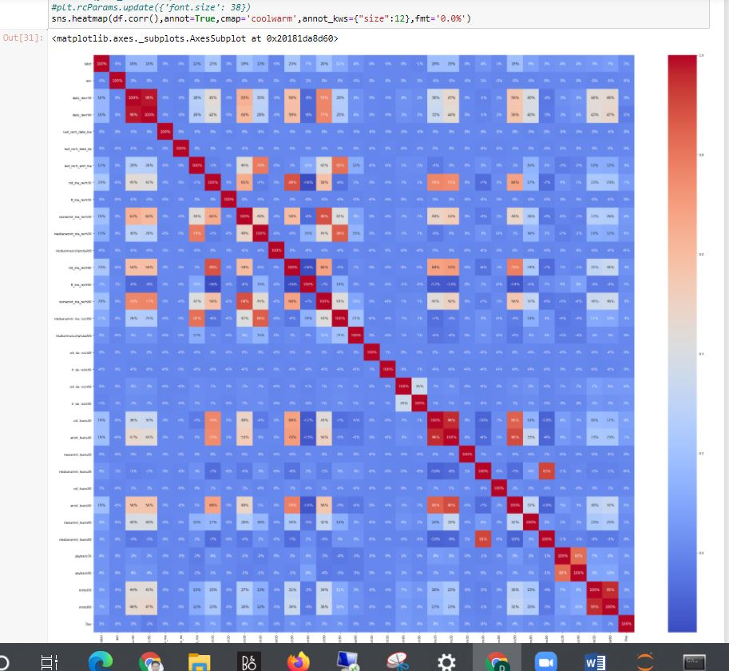

Slide 19
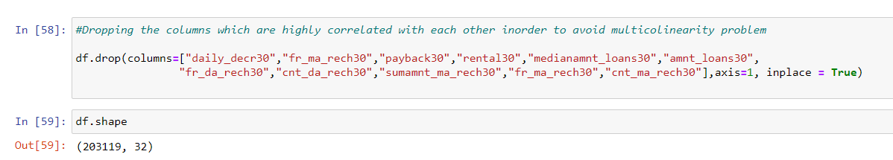

Slide 20
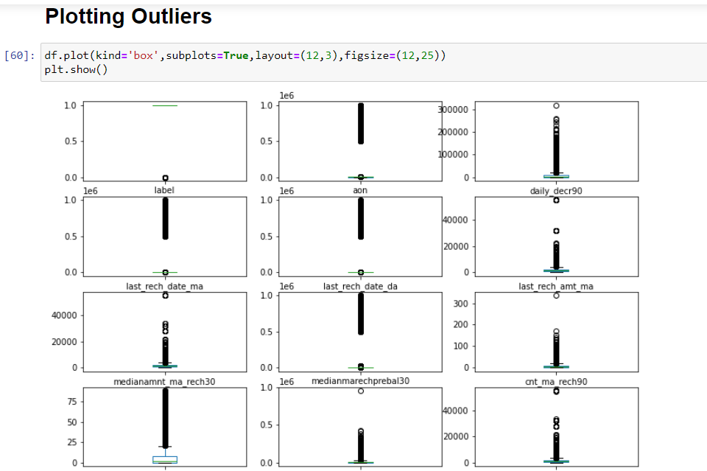

Slide 21
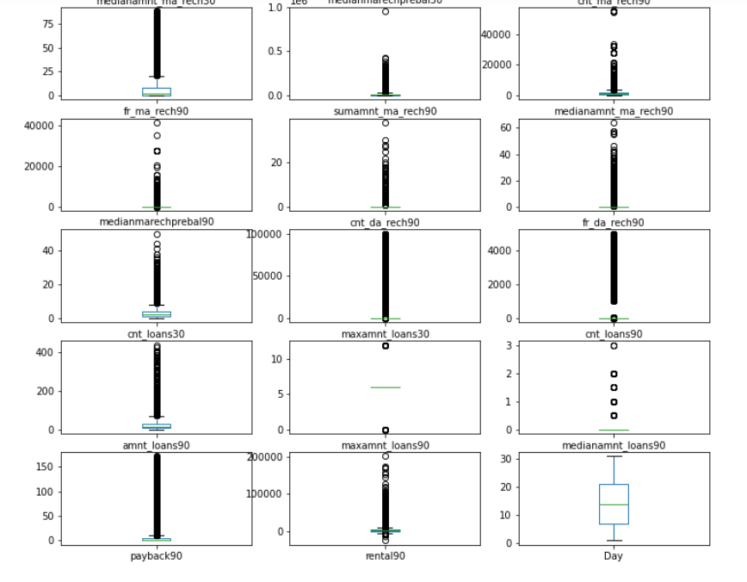

Slide 22
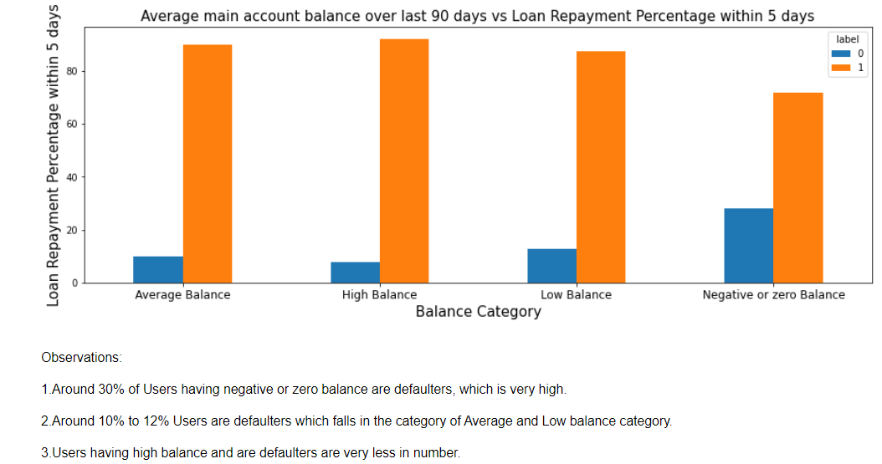

Slide 23
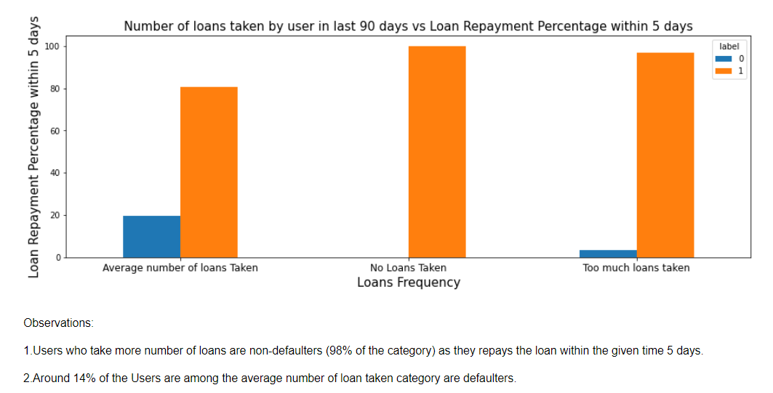

Slide 24
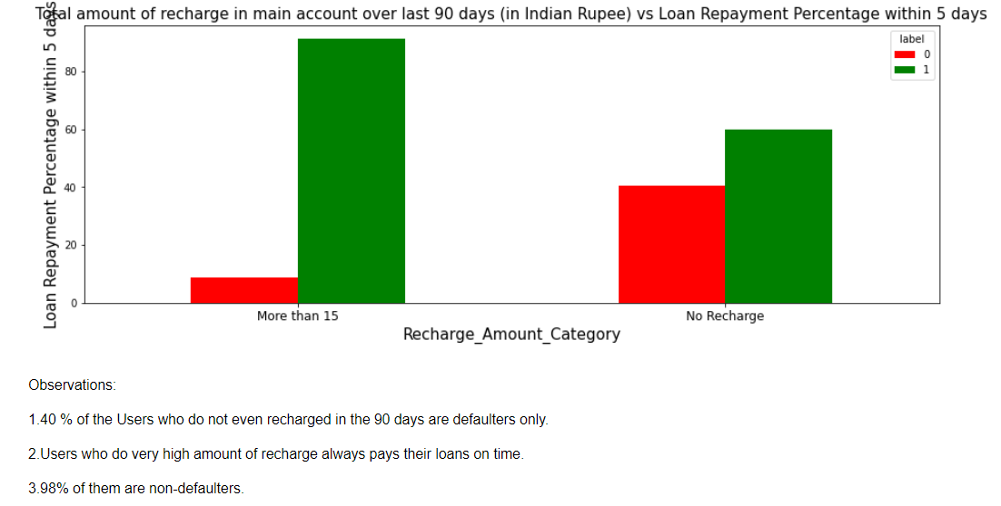

Slide 25
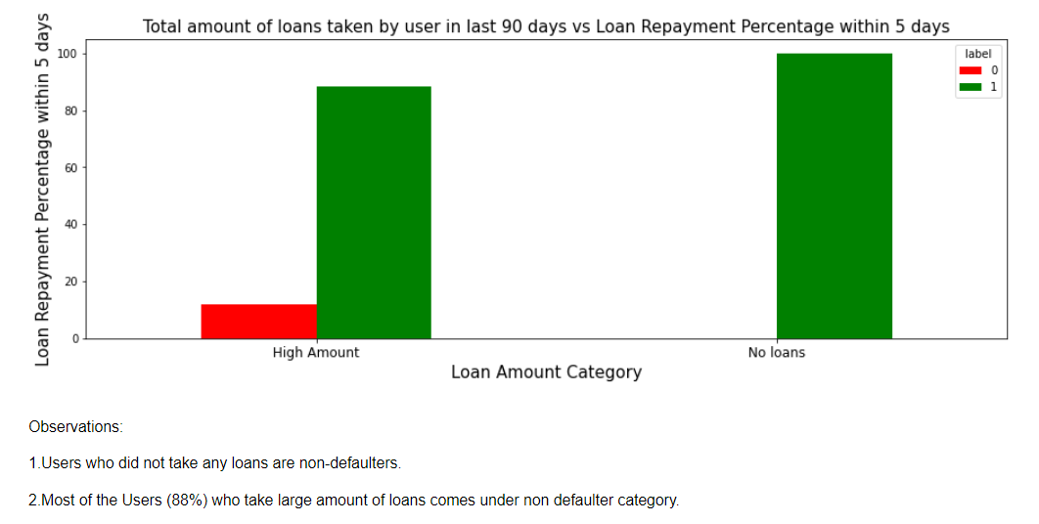

Slide 26
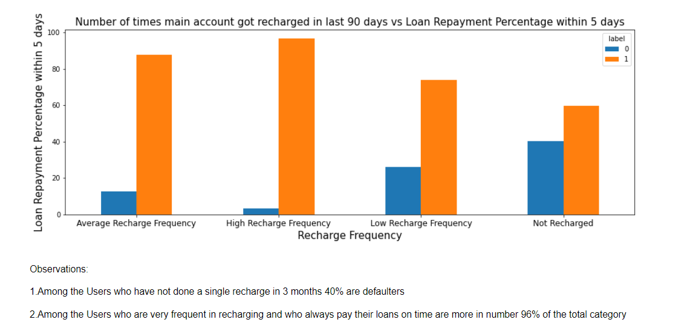

Slide 27
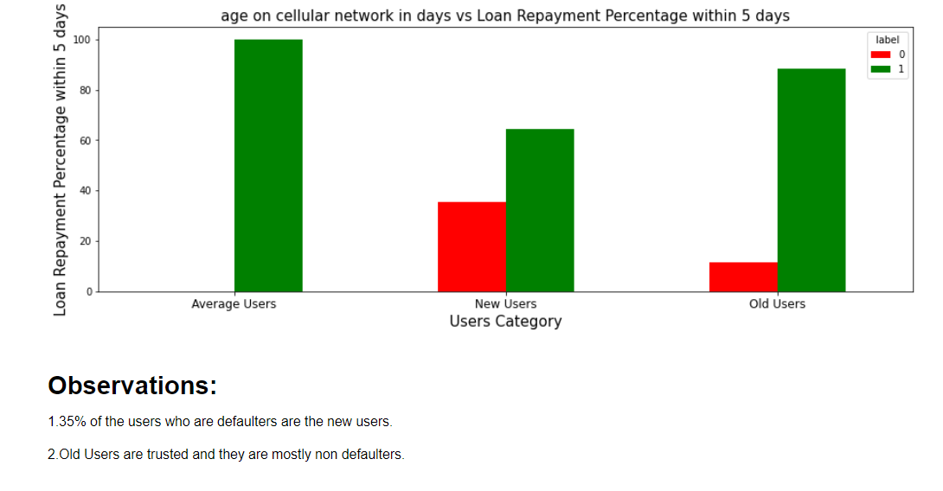

Slide 28
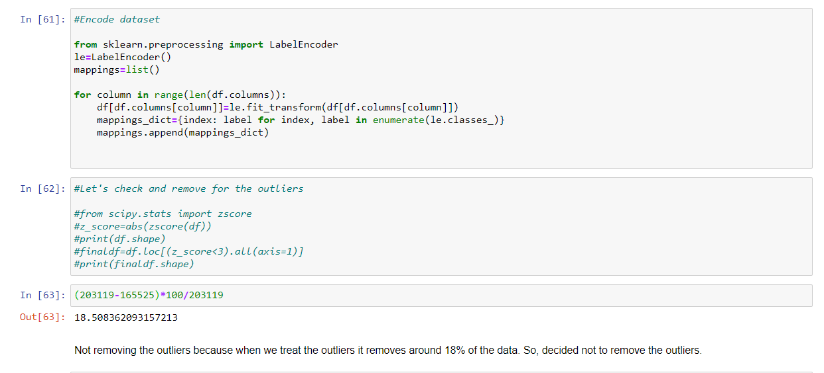
Model Pre-Processing

Slide 29
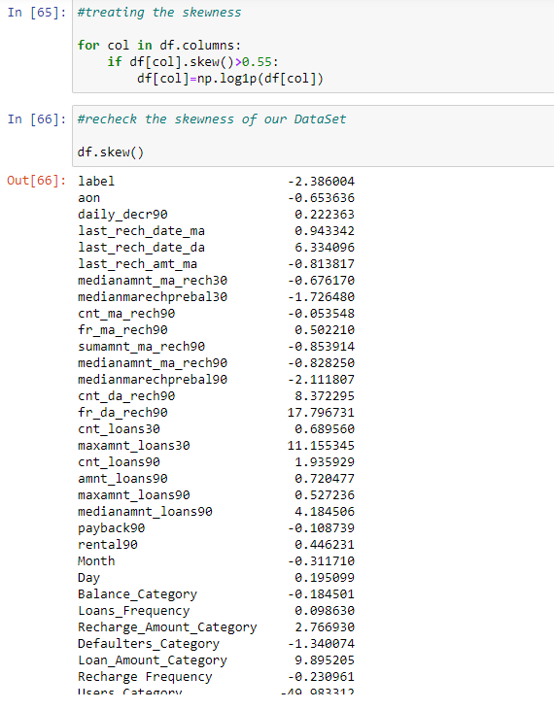
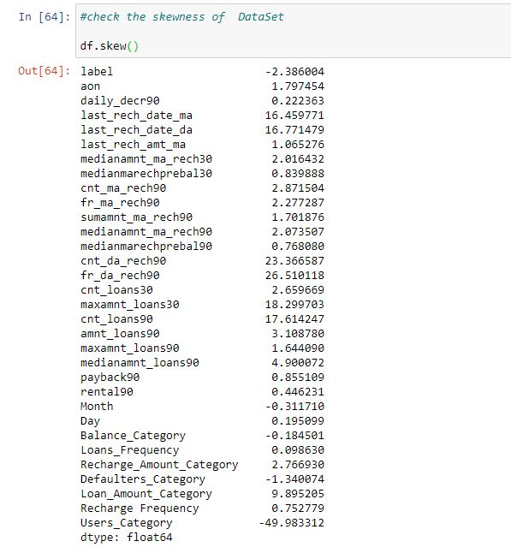

Slide 30
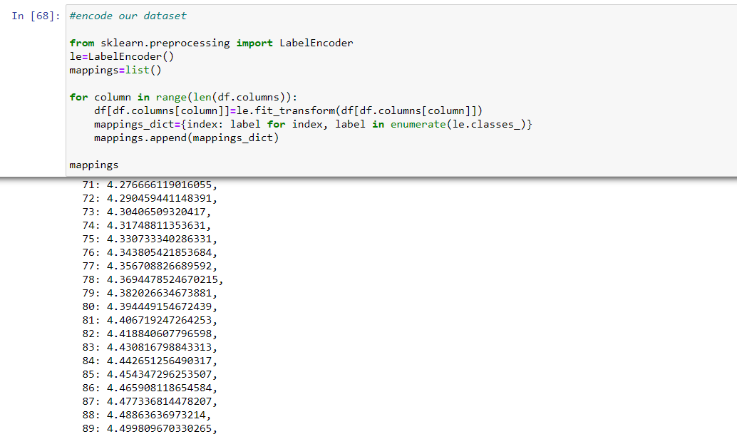

Slide 31
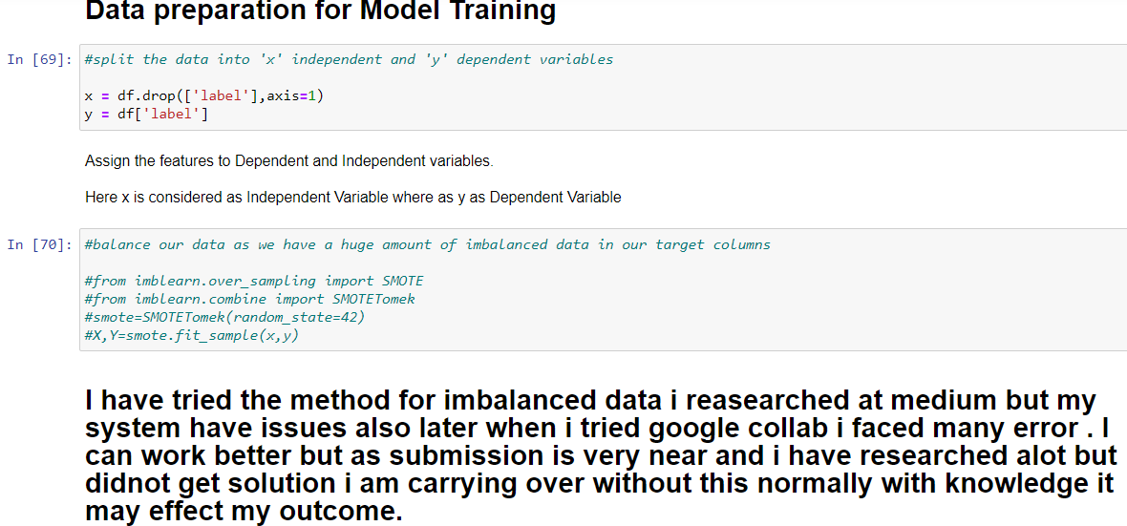
Model Training

Slide 32
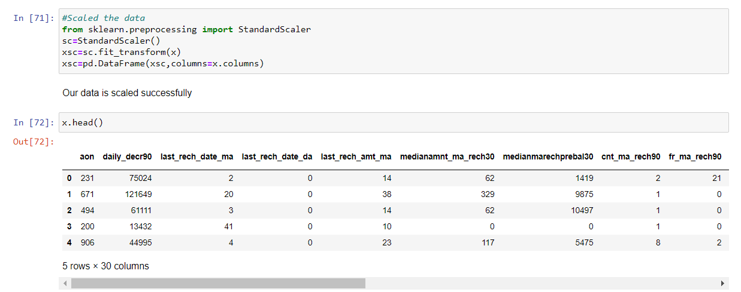

Slide 33
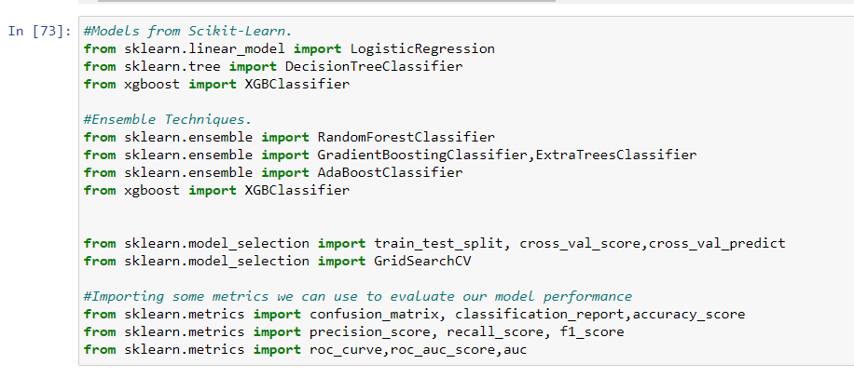

Slide 34
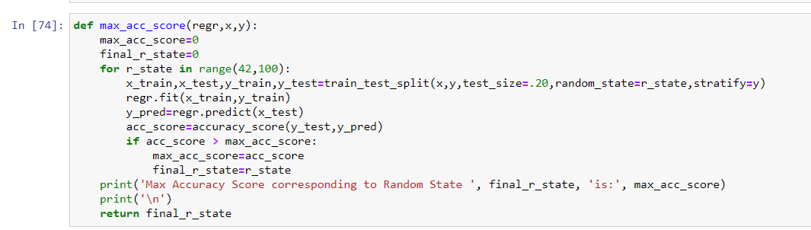

Slide 35
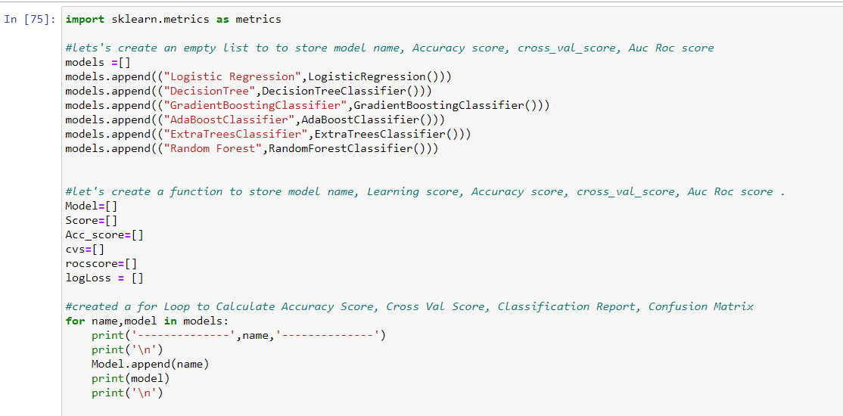

Slide 36
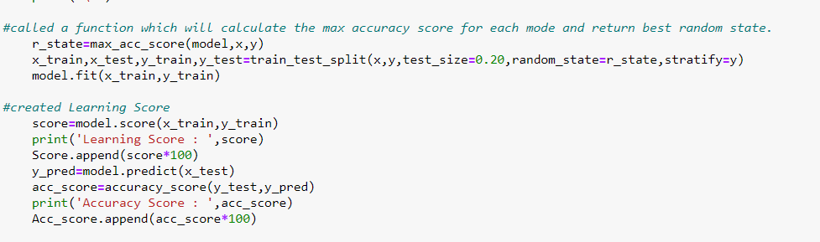

Slide 37
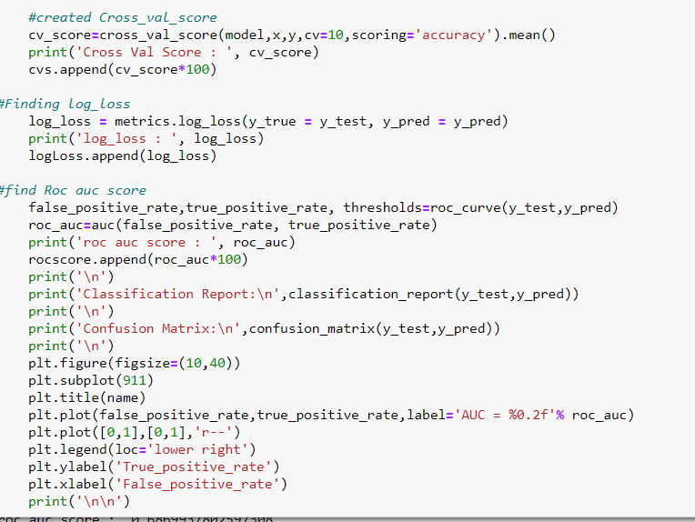

Slide 38
Model Development & Evaluation
After cleaning all the features, the input set of features are standard scaled for modelling
Algorithms tested for classification of defaulters:
Logistic Regression
RandomForest Classifier
AdaBoost Classifier
GradientBoosting Classifier
Decision Tree Classifier

Slide 39
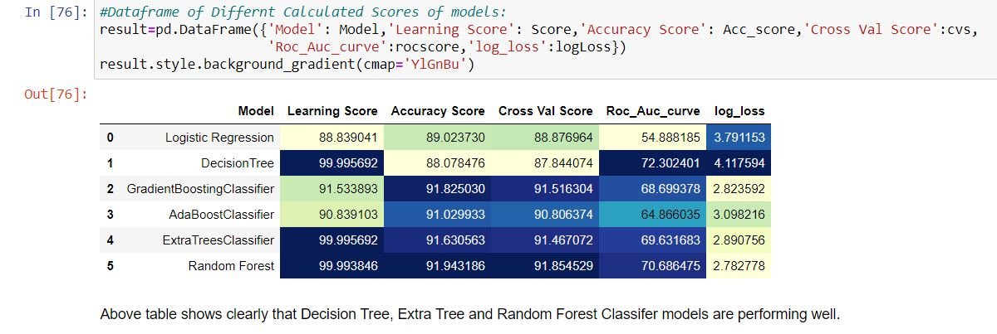
Summary of Results
It might appear from the accuracy and cross validation scores that Ensemble methods are performing better but if we look at the confusion matrix and recall scores, we observe that these models are not good at classifying the defaulters.

Slide 40
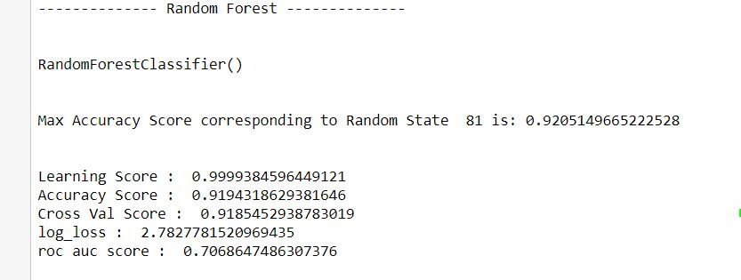
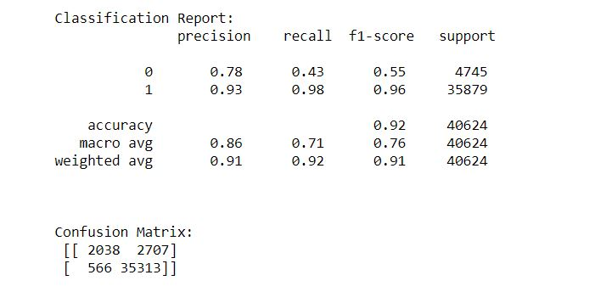
RandomForestClassifier

Slide 41
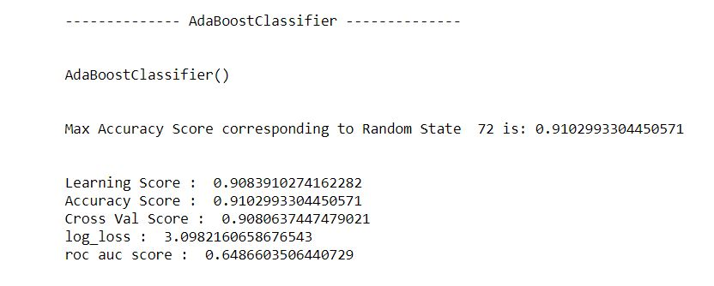
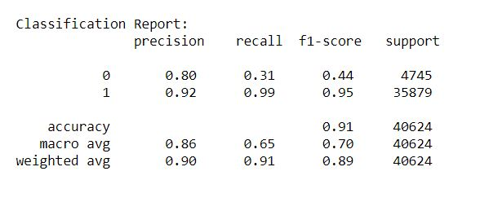
AdaBoostClassifier

Slide 42
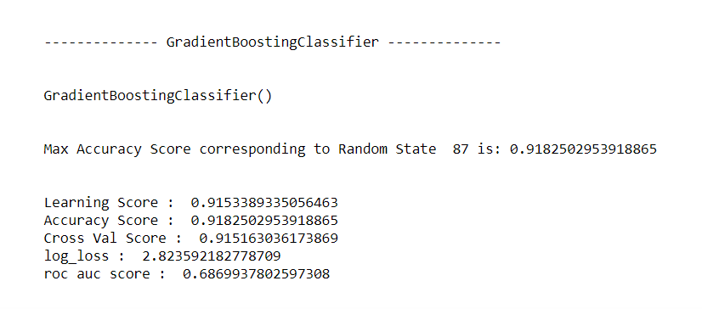
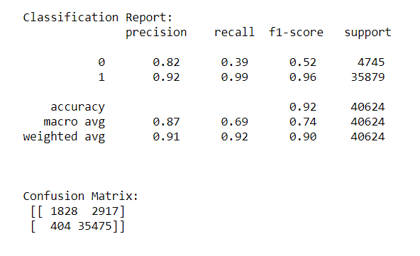
GradientBoostingClassifier

Slide 43
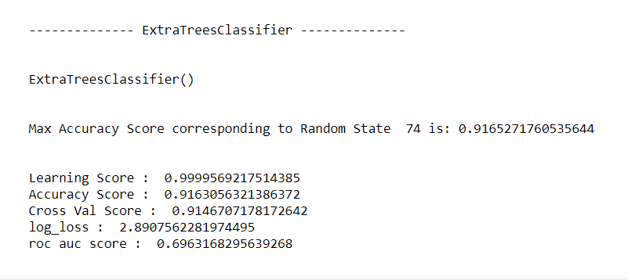
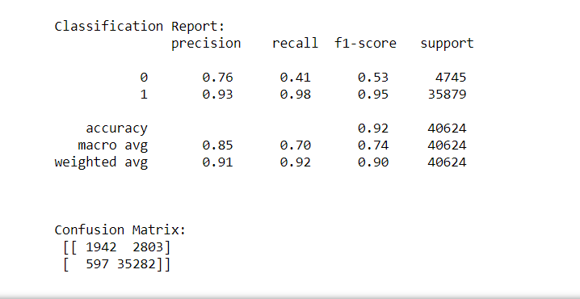
ExtraTreeClassifier

Slide 44
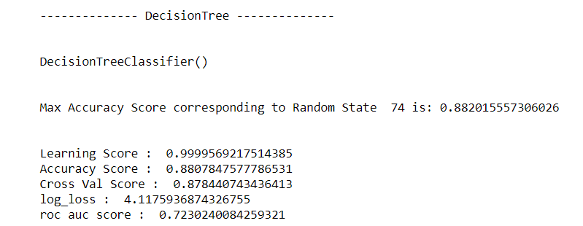
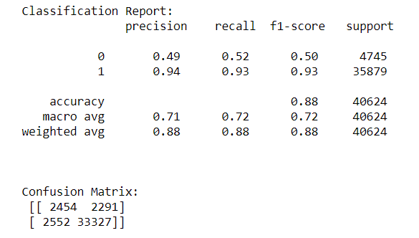
DecisionTreeClassifier

Slide 46
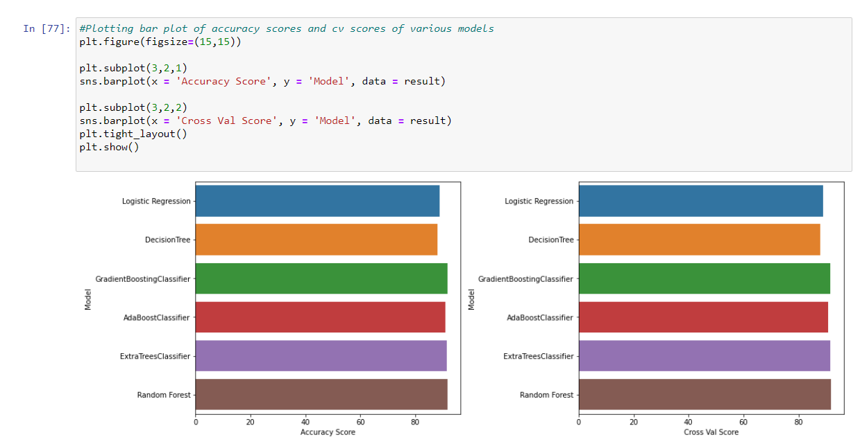

Slide 47
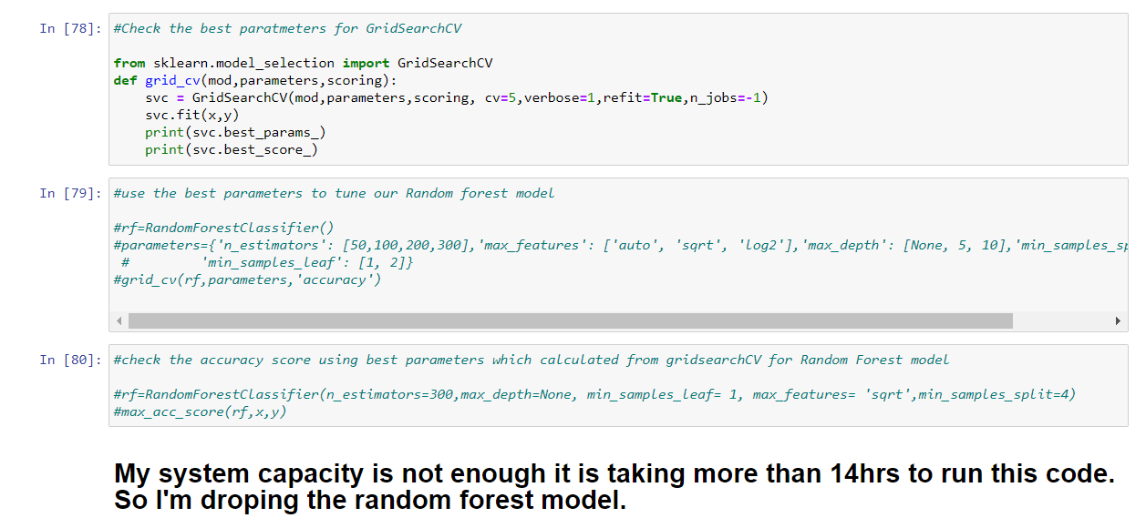

Slide 48
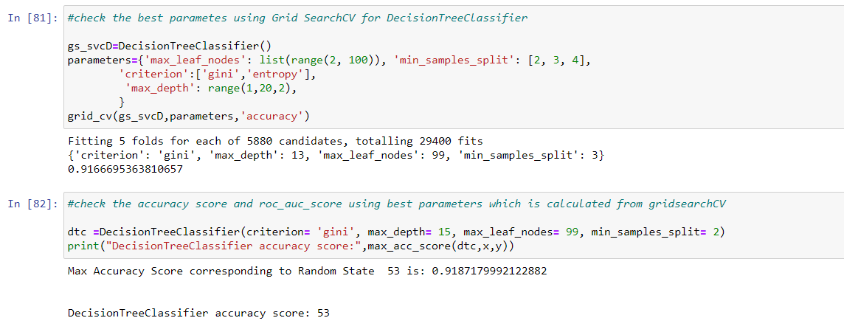

Slide 49
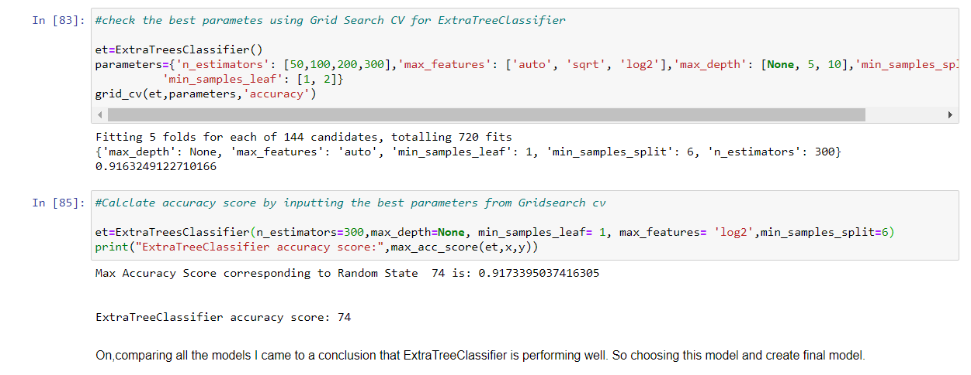

Slide 50
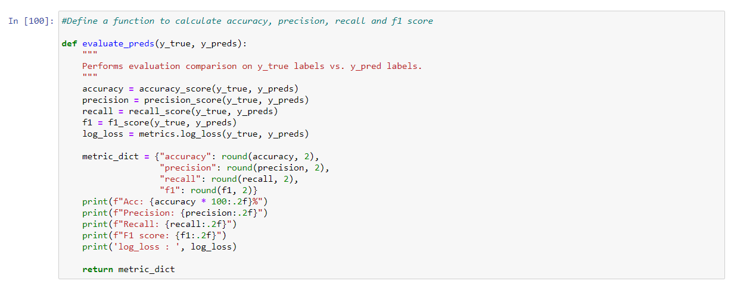

Slide 51
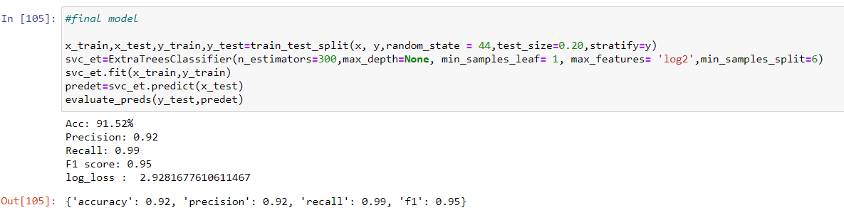

Slide 52
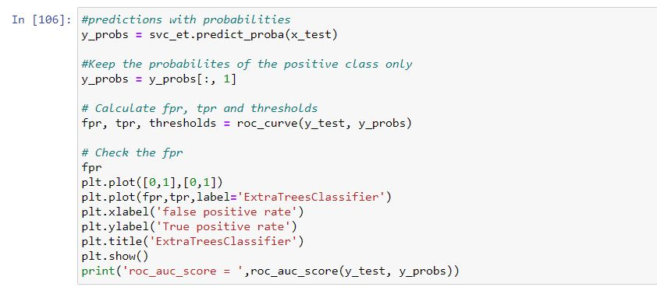


Slide 53


Slide 54


Slide 55


Slide 56


Slide 57
Conclusion of the Project
1) Around 28% users are defaulters with a mostly negative or null balance.
2) Users with high equilibrium and a much lower number are defaulters.
3) Nonstandard loans (98 percent of the category) are paid to users who take up more loans as they pay back the loan within 5 days.
4) 10% to 12% of users are defaulters in the Average and Low Balance categories.
5) Non-defaulting users who have taken no loans.
6) Around 97% users are taking large loans which fall into non-default categories.
7) Defaulters include 40 percent of the users that do not have a single recharge in 3 months.
8) Around 14 percent of users fall into the category of defaulting loans, on average.
9) The default is only 40% of users who do not reload in 90 days.
10) Users who recharge very high pay their loans on time. That is, 98% of them are non-defaulting ones.
11) defaulting is 34 percent of users who reload less.
12) Old and largely non default users are trusted
13) 17% of users receiving small loans are non-performing.
14) The new users constitute 32% of the users defaulting.
15) The number of users who recharge and pay their loans on time is 99 percent more than that of defaulters.

Slide 58
Conclusion of the Project
From the data analysis we found that the following types of users are generally more likely to default:
Short-time users
Users with lesser average daily amount spent
Users with lesser average main account balance
Users who recharge less frequently or lesser number of times over 30/90 days
Users who recharge lower amounts
Users who recharge lower total amounts over 30/90 days
Users with lower median of amount of recharges over 30/90 days
Users with lower median of main account balance just before recharge
Users who take loans less frequently or lower number of loans taken over 30/90 days
Users who take lower total amounts as loans over 30/90 days
Also 6 Rupiah loans were defaulted more frequently when compared to 12 Rupiah loans.

Slide 59
Limitation of the project and future scope
The I came across are time limitation, my system capacity if these are of suffiecient I could have work better than this.
The future scope of project is that we can train machine to indetify and restrict fraudulent through micro credit loan business.
This could further be used in other buisnesses by restricting fraudaulent and generate income.
We can use other techniques like featured engineering,PCA, and different boosting algorithm to retrieve better results.
The major limitation in dataset I faced was presence of lots of outliers and as data was expensive I couldnot drop it and with those outliers my analysis is not very accurate.

Slide 60
Thank You

